Slide 1
American Legal System:
Research Refresh
Notes:
NOTE:
To change the image on this slide, select the picture and delete it. Then click the Pictures icon in the placeholder to insert your own image.

Slide 2
Why do we have laws?

Slide 3
Laws & Values

Slide 4
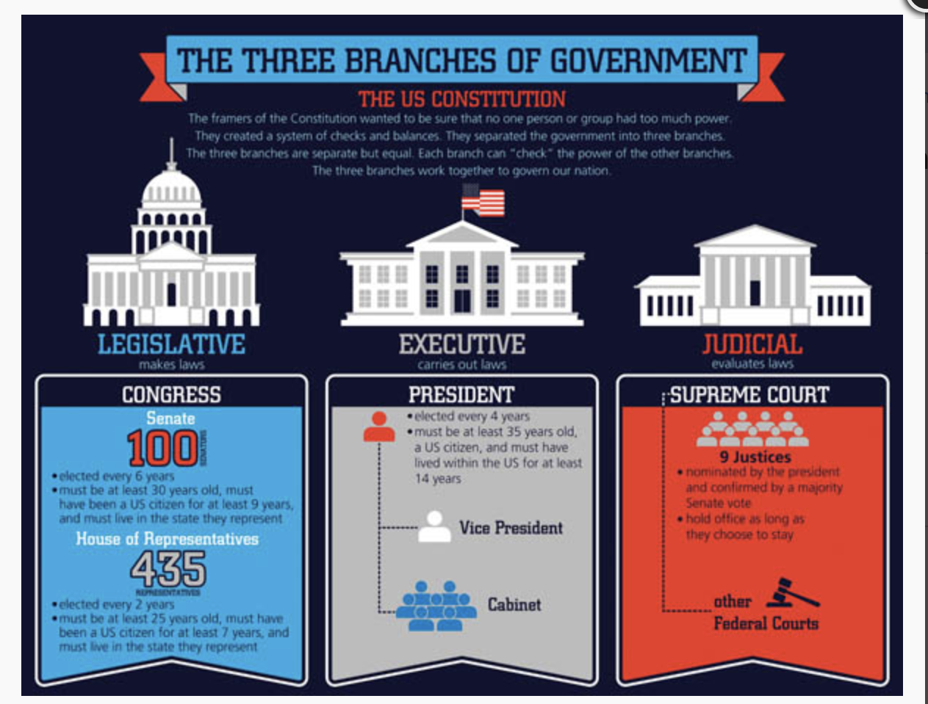
Separation of Powers

Slide 5
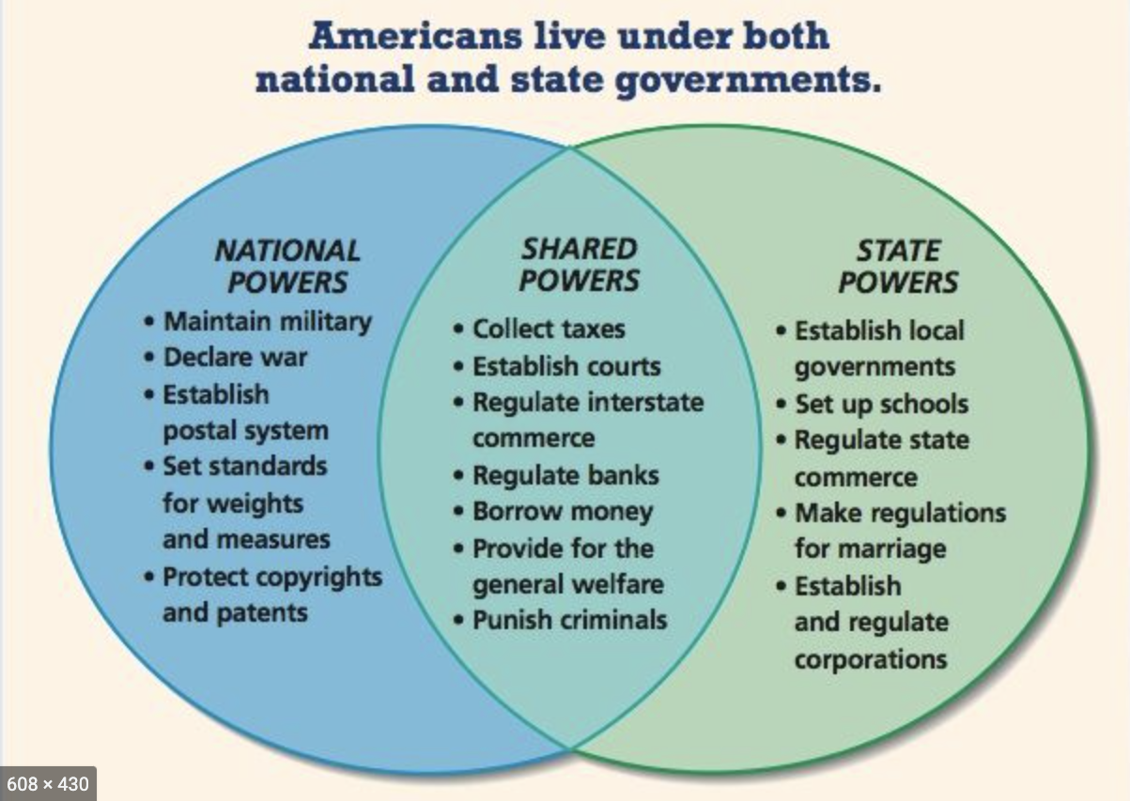
Federalism

Slide 7
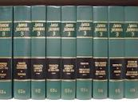
Secondary Sources
Encyclopedias
Articles
Books
American Law Reports
Restatements

Slide 8
Presidential Election Law Exercise
Jurisdiction?
Google Search – Who decides who will be President? Discussion
Fact Pattern Review
Groups discuss a source
Report out

