Slide 1
FGLP: Pre-Law Advising Refresher
Bradley A. Mueller, J.D.
Senior Pre-Law Advisor

Slide 2
Overview of the Pre-Law Advising Refresher:
Re-introductions
ABA Law School Prep Guidelines
A few quizzes
Review of some basics from last year
Pre-law advising and other resources
Questions
Notes:
How presentation will benefit audience: Adult learners are more interested in a subject if they know how or why it is important to them.
Presenter’s level of expertise in the subject: Briefly state your credentials in this area, or explain why participants should listen to you.

Slide 3
Who am I?
I was a first-generation college student/law student
UW- Eau Claire
John Marshall Law School (now UIC School of Law)
Legal career
Volunteered at non-profits & Cabrini Green Legal Aid
Pre-Law Advisor at UIC in April 2016

Slide 4
Please reintroduce yourself:
NAME
COLLEGE ATTENDING
MAJOR – if you know, it’s fine not to have declared one yet!

Slide 5
Our Sessions Together – Summer 2024
Today-June 18th: Pre-Law Advising Refresher
June 24th: Exploring the Legal Profession
July 1st (Zoom): Pre-Law Course Planning Strategies
July 8th: Beyond the Classroom
July 22nd: Letters of Recommendation

Slide 6
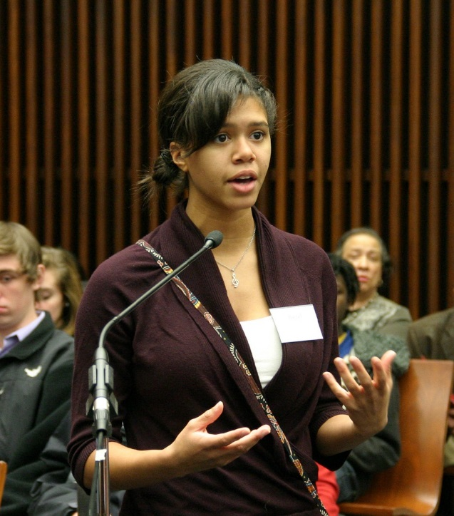
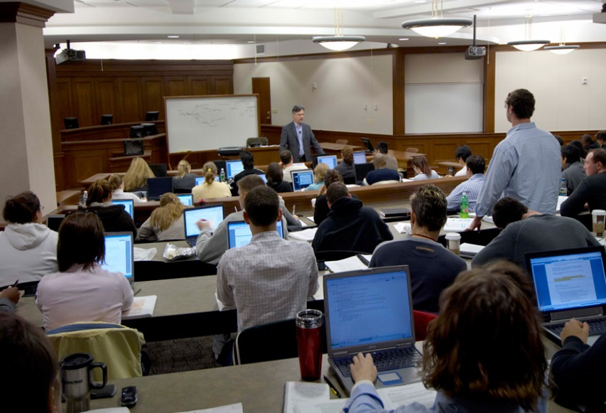
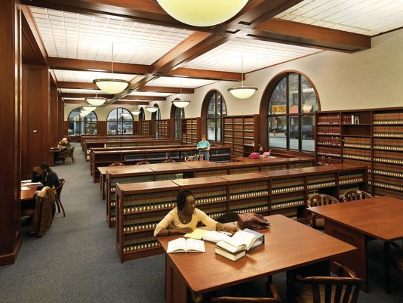
Do you remember the skills a first-year law student should have to be successful in law school?

Slide 7
AMERICAN BAR ASSOCIATION (ABA) Core Skills, Values, Knowledge, and Experience for Law School
Problem Solving
Critical Reading
Writing and Editing
Oral Communication and Listening
Research
Organization and Management
Public Service and Promotion of Justice
Relationship-building and Collaboration
Background Knowledge
Exposure to the Law

Slide 8
ACTIONS YOU CAN TAKE TO GAIN ACCEPTANCE TO LAW SCHOOL AND TO PREPARE TO SUCCEED ONCE ADMITTED
Select courses that require you to read, analyze and question
Select courses that require you to write extensively
Select courses that challenge you to speak in class and/or make presentations
Work hard to earn the best grades you can your freshmen year
Develop solid academic relationships with professors (future Letters of Recommendation)
Explore and pursue volunteer/internship opportunities and be involved student organizations (don’t have to be law related)
Ask: Why do I want to get a law degree?
Notes:
Pictures movie clip stats

Slide 9
Undergraduate course selection
No specific majors required for law school
No pre-requisite courses required for law school
Introductory Logic course recommended across the board for LSAT prep-even with change in LSAT (not required)
-Second semester soph year or junior year
- Help prepare for the Law School Admission Test (LSAT)
Use undergrad experience to gain basic knowledge about U.S. history, political system/government, society, economics
Take courses that interest you! Explore subjects you are curious about! College is the time to explore and take safe risks!
Notes:
Example objectives
At the end of this lesson, you will be able to:
Save files to the team Web server.
Move files to different locations on the team Web server.
Share files on the team Web server.

Slide 10
No one “best” major for law school
Law schools are not looking to have a student body comprised of all Political Science majors-or any one major!
Law schools want a diverse student body-in all respects.
Choose a major that interests you and plays to your strengths.
Law and legal careers affect all aspects of U.S. (and global) society-lawyers needed with varied backgrounds.
You don’t need to know what kind of law you’re going to practice before going to law school.

Slide 11
Student Involvement Outside the Classroom
No specific checklist for what to be involved in
Students should pursue their interests, be it student organizations, community involvement, volunteering, work, internships, research, study abroad, etc.
LEADERSHIP
Quality over quantity

Slide 12
Internships, Jobs, Volunteering
Look for opportunities that make you a well-rounded law school candidate
Do not have to be specifically “law” related
Service to others

Slide 13
Resume tip for law school, jobs, and internships
Make lists and keep track of things you do, learn, and accomplish during your experiences at work, internships, student organizations, and volunteer activities.

Slide 14
Talk to lawyers – informational interviews
Best way to learn about a profession is to talk to individuals in that profession
Most professionals love to talk to young people who are exploring their career options
Use the internet to find professionals to connect with; family connections
Ask them about their education, their career path, what do they like/dislike about their job
Practice informational interviewing this week!

Slide 15
Personal Considerations
Act Responsibly
Law school applications (Character & Fitness questions)
Required to report misconduct on law school applications/Bar admission
Save information about issues you may have
Social Media/Email issues
Post only appropriate images
Be positive, avoid negative posts/comments
Privacy settings
Assume law schools are going to check your social media footprint
Use correct grammar/proofread
Practice communicating in a professional manner

Slide 16
REACH OUT & TAKE ADVANTAGE OF YOUR SCHOOL’S RESOURCES!!!!
Use this summer to practice your networking skills, ask lots of questions
Meet with the pre-law advisor at your college
Participate in/attend pre-law events and programming
Use career develop or career services offices (help with internships, deciding on a major/minor)
Use your school’s academic support services; such as peer tutoring, writing center (it’s good to get help!)
At most colleges, lots of people there to help: YOU NEED TO REACH OUT!!!
Notes:
Send you all a copy of the PP, leave your email address on the sheet located near the door.

Slide 17
NO ONE EXPECTS YOU TO HAVE THIS ALL FIGURED OUT
YOU’VE NEVER DONE THIS BEFORE!!!!

Slide 18
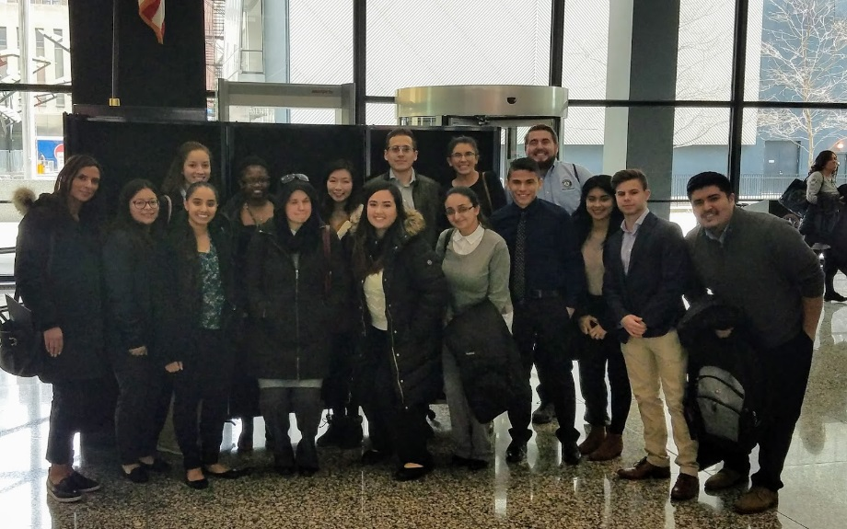
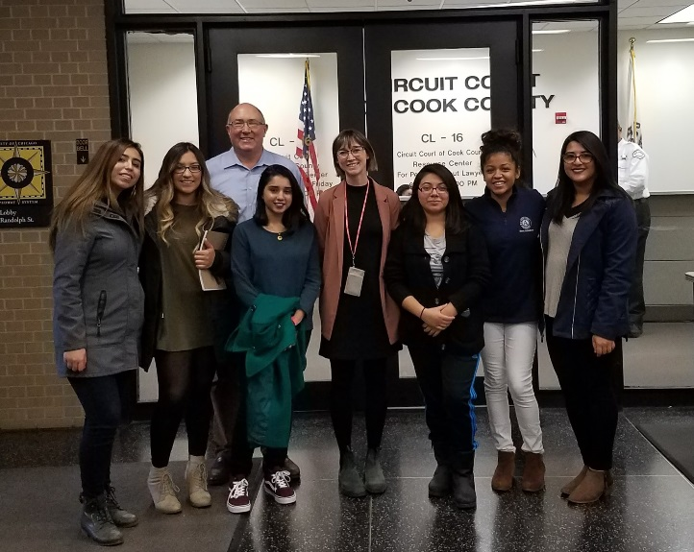
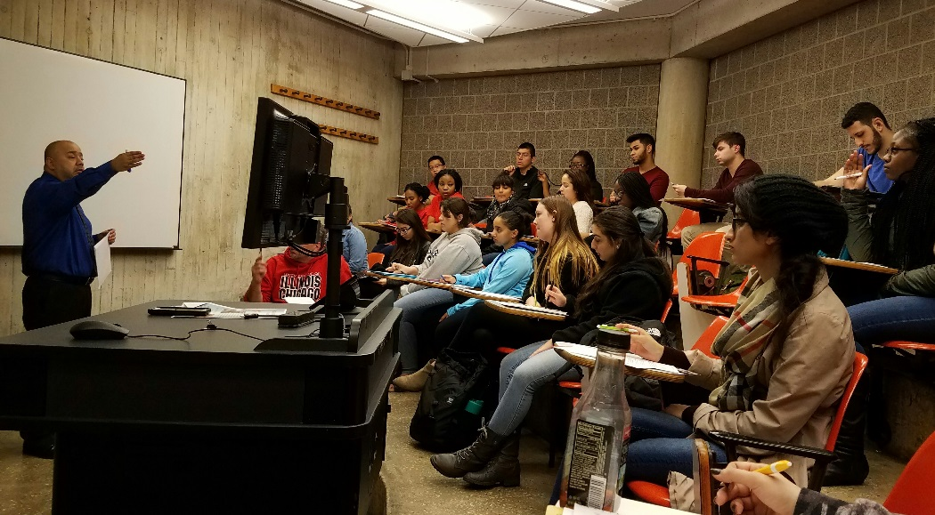
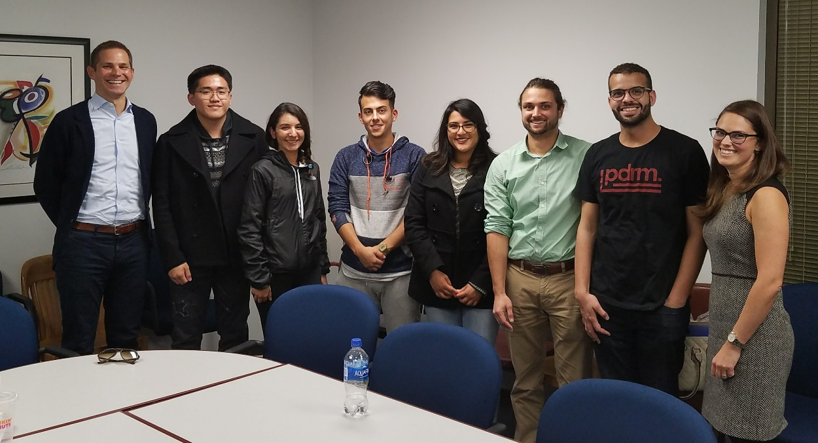
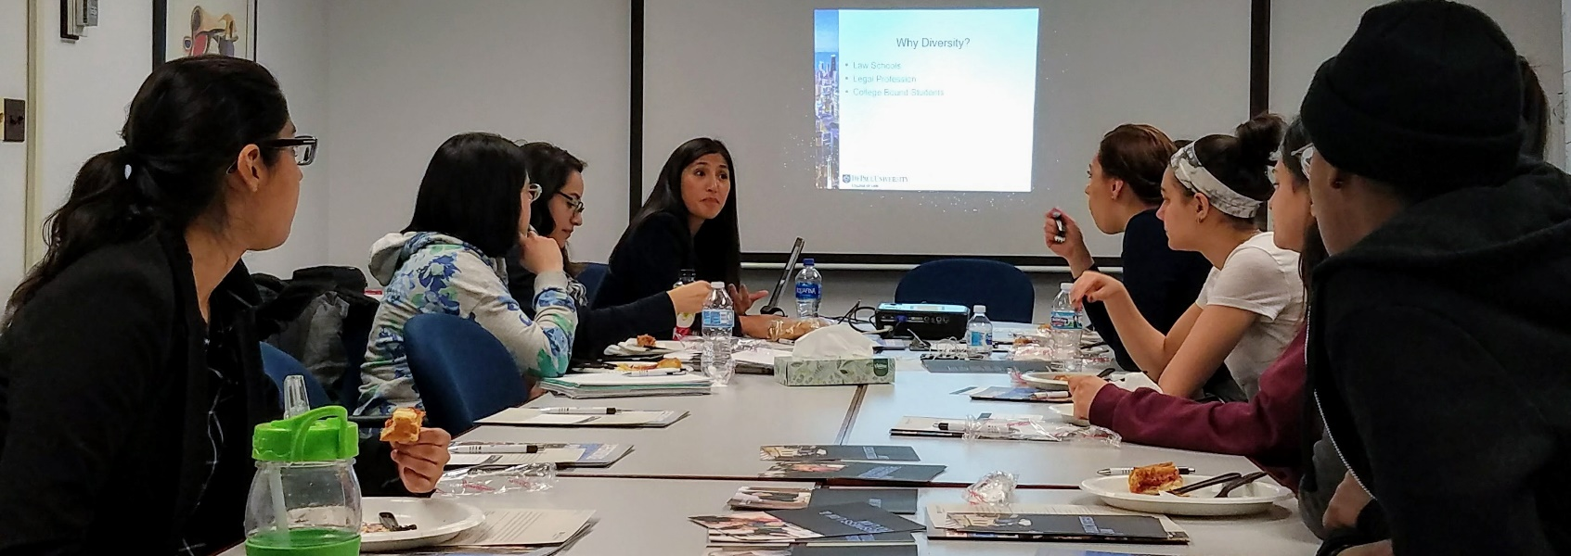
Attend Pre-Law events at your college!!

Slide 19
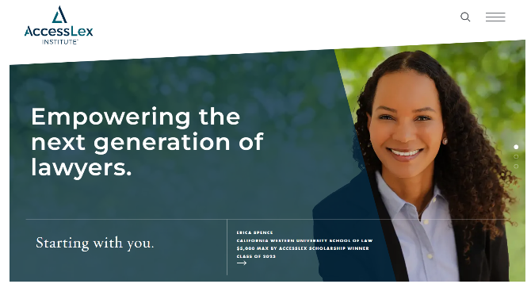
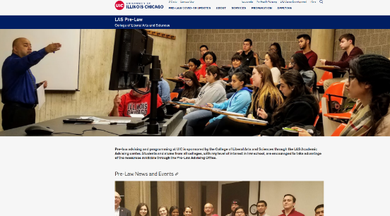
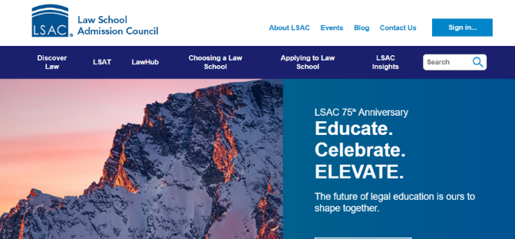
Websites to checkout
LSAC lsac.org
(Law School Admission Council)
UIC Pre-Law Advising prelaw.las.edu
AccessLex accesslex.org

Slide 20
Many paths (and timelines) to law school

Slide 22
Movies and books about law school/lawyers.
Movies
Books
The Paper Chase (1973)
Legally Blonde (2001)
Rounders (1993)
My Cousin Vinny (1992)
The Firm (1993)
Philadelphia (1993)
To Kill a Mockingbird (1962)
12 Angry Men (1957)
Erin Brockovich (2000)
A Few Good Men (1992)
The Verdict (1982)
One L by Scott Turow
To Kill a Mockingbird by Harper Lee
The Story of My Life by Clarence Darrow
24 Hours with 24 Lawyers by Jasper Kim
Invisible Man by Ralph Ellison
The Defense Never Rests by F. Lee Bailey
In the Shadow of the Law by Kermit Roosevelt
Just Mercy by Bryan Stevenson
Presumed Innocent by Scott Turow
Civility: Manners, Morals and the Etiquette of Democracy by Stephen L. Carter

