Slide 1
Advocacy
FGLS
Summer 2024

Slide 2
What is advocacy?
Advocacy is the active support of a cause or action
Attending a local school board meeting and speaking publicly about the importance of music classes would be advocating for those classes.
Other examples?

Slide 3
Lifeline of a case in the trial court– Civil Case
Factual/Procedural Context |  | Documents Attorneys Draft
Client seeks attorney’s advice. Lawsuit may or may not be filed. |  | Office Memorandum Client Advisory/Opinion Letter Demand for Settlement Letter | If case settles or attorney determines there is no merit to suit, case concludes
 | Courthouse
Plaintiff begins lawsuit by filing a Complaint in the courthouse |  | Service of Summons Complaint (or Petition, TRO)
Defendant responds, often with a Motion |  | Motion to Dismiss for Failure to State a Claim Motion to Remove Motion for More Definite Statement | If granted, case dismissed or removed to another court.

Slide 4
Lifeline of a civil case cont’d
Factual/Procedural Context |  | Documents Attorneys Draft
If the lawsuit survives the defendant’s motions or no motions are filed, the defendant Answers the allegations of the complaint |  | Answer Affirmative Defenses Cross-claim Third-Party Complaint
After the defendant answers and any third-parties are sued and answer, parties engage in Discovery to obtain information about the case: written and oral |  | Interrogatories Requests for Documents Requests to Admit Facts Motions to Compel Motions for Sanctions
If, after the discovery is completed, defendant believes that plaintiff cannot prove the facts stated in complaint, defendant can move for Summary Judgment |  | Motion for summary judgment | If summary judgment is granted and if it disposes of all issues before the court, case is concluded.

Slide 5
Lifeline of a civil case cont’d
Factual/Procedural Context |  | Documents Attorneys Draft
If the complaint survives summary judgment, the case will proceed to trial |  | Motions in limine Final Pretrial Order (federal ct.) Motions for directed verdicts Jury Instructions | If motion for directed verdict is granted, case concludes unless an appeal is filed.
Jury or bench trial = verdict |  | Post-trial motions Notice of Appeal and sometimes cross-appeal, Appellate briefs | If neither side appeals, jury (or bench) verdict stands and case is concluded.
 | Appellate Court

Slide 6
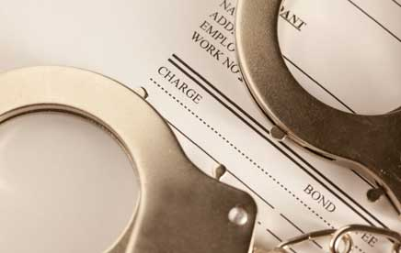
Typical pre-trial proceedings in a criminal case
After the arrest, the state begins its formal prosecution:
Complaint
Initial Appearance: Probable Cause
Determination
Information or Indictment
Arraignment: Defendant enters a Plea
Motion to Dismiss
Discovery
Motion to suppress

Slide 7
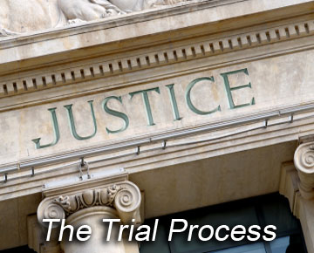
Typical stages of a criminal trial
Jury selection
Opening statements
Government’s case-in-chief
Motion for judgment of acquittal
Defendant’s case-in-chief
Rebuttal
Closing Argument
Jury Instructions
Verdict

Slide 8
Common post-trial motions in criminal cases
Motion for judgment of acquittal
Motion to stay sentence
Motion for a new trial

Slide 9
Entry of judgment; Sentencing; Appeals & Post-Conviction Remedies
The judgment must state the plea or jury verdict
and if the defendant has been found
guilty, the judgment imposed.

Slide 10
Types of advocacy
The processes by which the actions of individuals or groups attempt to bring about social and/or organizational change on behalf of a particular goal, program, interest, or population.

Slide 11
Advocacy campaigns
Advocacy campaigns have a significant role in driving change and raising awareness about various issues. The campaigns mobilize communities, spotlight perspectives, and act as catalysts for change in policies and practices at various levels of government and society.
Advocacy campaigns can influence political decisions, create a sense of community and solidarity, and promote causes that matter to the broader public. Whether those campaigns drive political change, raise issue awareness, or bring people together, they can massively impact a part of society and its members.

Slide 12
Have you been involved in any advocacy work?

Slide 13
Ice Bucket Challenge
Campaign to promote awareness of amyotrophic lateral sclerosis (ALS) — also known as Lou Gehrig's disease — and encourage donations for research.
A person is filmed as a bucket of water and ice is dumped over the individual's head. The individual then nominates a minimum of three people to do the same thing, having only a 24-hour time frame to complete the challenge and make a donation to the Amyotrophic Lateral Sclerosis Association.
More than 17 million people posted videos online, including Bill Gates and former president George W. Bush.
Raised $115 million that helped fund research and development of treatment drugs.
https://www.usatoday.com/story/news/2017/07/03/ice-bucket-challenge-5-things-you-should-know/448006001/

Slide 14
What do advocates do?
Help an individual or group accomplish goals by providing resources, like money or supplies
See a problem and work to find a solution
Speak up for a cause and educate others as to why this particular cause is important

Slide 15
What do legal advocates do?

